Slide 1



Wellcome
To
Ethical Hacking class
3rd Week
Day 3rd
Muhammad Bilal

Slide 2
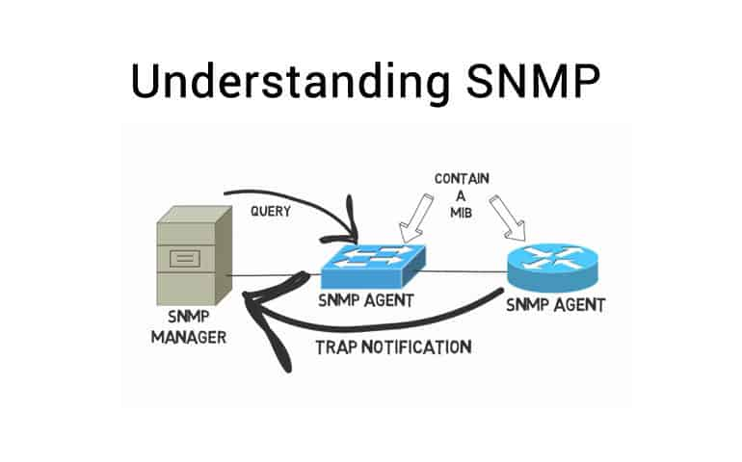
SNMP Enumeration
Definition:
SNMP (Simple Network Management Protocol) enumeration involves gathering information about network devices, such as routers, switches, and computers, using SNMP. This protocol allows administrators to monitor and manage network performance, find network issues, and track network configurations.
Examples:
1. Using SNMP to retrieve a list of network interfaces and their configurations on a router.
2. Collecting system uptime and performance metrics from a server.

Slide 3
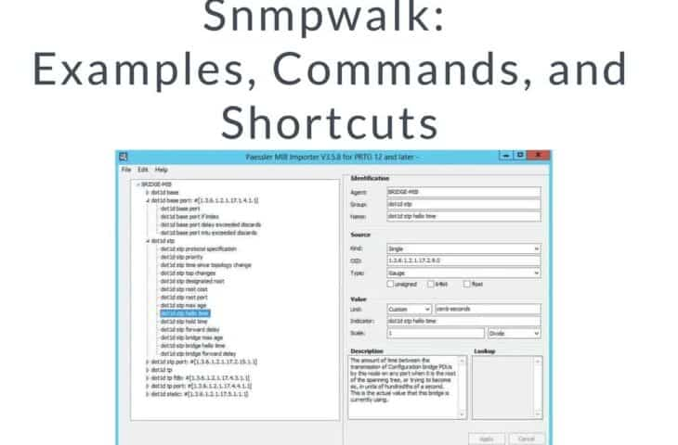
SNMP Enumeration
Techniques and Tools:
Tools: SNMPwalk, SNMPCheck, SolarWinds SNMP Enabler.
Techniques: Use SNMPwalk to query devices for available SNMP data using community strings. Scan for default SNMP community strings like "public" and "private."

Slide 4
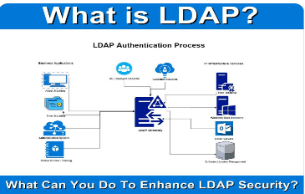
LDAP Enumeration
Definition:
LDAP (Lightweight Directory Access Protocol) enumeration involves extracting information from directory services like Active Directory. It can provide data about users, groups, roles, and other networked resources.
Examples:
1. Retrieving a list of users and their email addresses from an LDAP directory.
2. Extracting group membership details from Active Directory.
Techniques and Tools:
Tools: ldapsearch, JXplorer, Softerra LDAP Browser.
Techniques: Use ldapsearch to query the LDAP directory for objects and attributes. Try anonymous binds or weak credentials to access information.

Slide 5
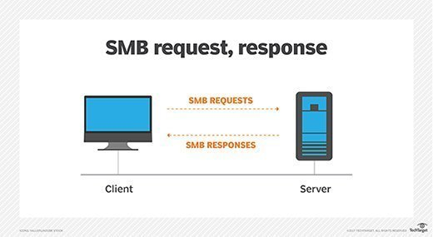
SMB Enumeration
Definition:
SMB (Server Message Block) enumeration is the process of collecting information from Windows-based networks, such as shared resources, user accounts, and services, using the SMB protocol.
Examples:
1. Listing shared folders on a network using SMB.
2. Enumerating user accounts with shared access permissions.
Techniques and Tools:
Tools: enum4linux, smbclient, Nmap (with smb scripts).
Techniques: Use enum4linux to list shares, users, and policies. Check for null session vulnerabilities.

Slide 6

DNS Enumeration
Definition:
DNS enumeration involves gathering information about DNS records and configurations to map out domains and subdomains, IP addresses, and other DNS-related data.
Examples:
1. Identifying all subdomains of a target domain.
2. Retrieving MX (Mail Exchange) records to understand email server configurations.
Techniques and Tools:
Tools: nslookup, dig, DNSRecon, Sublist3r.
Techniques: Perform zone transfers to get complete DNS information. Use brute force and dictionary attacks to discover subdomains.

Slide 7
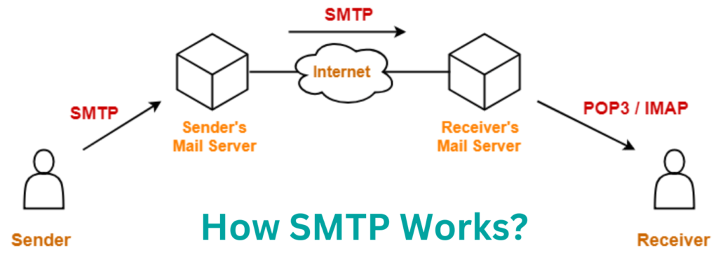
SMTP Enumeration
Definition:
SMTP (Simple Mail Transfer Protocol) enumeration involves identifying valid email addresses and other related information on an SMTP server.
Examples:
1. Validating email addresses on a server by using the VRFY command.
2. Checking for open relays on an SMTP server.
Techniques and Tools:
Tools: Telnet, smtp-user-enum, Metasploit (SMTP enumeration modules).
Techniques: Use the VRFY and EXPN commands to verify users. Test for open relay configurations.

Slide 8
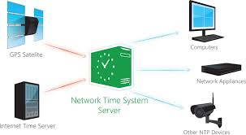
NTP Enumeration
Definition:
NTP (Network Time Protocol) enumeration involves gathering information from NTP servers, such as connected clients and server configurations.
Examples:
1. Listing the peers of an NTP server.
2. Collecting system time settings from network devices.
Techniques and Tools:
Tools: ntpdc, ntpq, Nmap (with ntp-info script).
Techniques: Use ntpq to query the server for peer lists. Check for publicly accessible NTP servers.

Slide 9
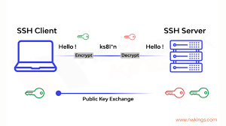
SSH Enumeration
Definition:
SSH (Secure Shell) enumeration involves identifying SSH server versions, configurations, and potential weak user accounts.
Examples:
1. Discovering the SSH server version and supported encryption algorithms.
2. Checking for weak SSH user accounts with default credentials.
Techniques and Tools:
Tools: Nmap (with ssh-brute and ssh2-enum-algos scripts), Hydra.
Techniques: Use Nmap to scan for open SSH ports and enumerate server details. Test for weak or default credentials with brute force.

Slide 10
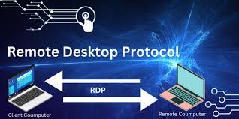
RDP Enumeration
Definition:
RDP (Remote Desktop Protocol) enumeration involves gathering information about remote desktop services, such as open ports and user accounts.
Examples:
1. Discovering open RDP ports on a network.
2. Enumerating user accounts with RDP access.
Techniques and Tools:
Tools: Nmap (with rdp scripts), rdpscan, Hydra.
Techniques: Scan for open RDP ports using Nmap. Test for weak credentials with brute force.

Slide 11

Port Enumeration Techniques
Definition:
Port enumeration involves scanning a network to identify open ports and services running on a system, helping to map the network structure and identify potential entry points.
Examples:
1. Identifying open HTTP and HTTPS ports on a web server.
2. Discovering open database ports like MySQL or PostgreSQL on a server.
Techniques and Tools:
Tools: Nmap, Masscan, Zenmap.
Techniques: Use Nmap to perform TCP and UDP scans. Employ service version detection and OS fingerprinting for detailed information.

Slide 12

User Enumeration
Definition:
User enumeration involves identifying valid usernames on a system or network, which can help attackers in brute-force attacks or gaining unauthorized access.
Examples:
1. Listing valid usernames on a web application login page.
2. Enumerating users on a WordPress site using the `/?author=1` method.
Techniques and Tools:
Tools: Metasploit, Burp Suite, WPScan.
Techniques: Use error messages and responses to infer valid usernames. Exploit specific application vulnerabilities for user enumeration.

Slide 13
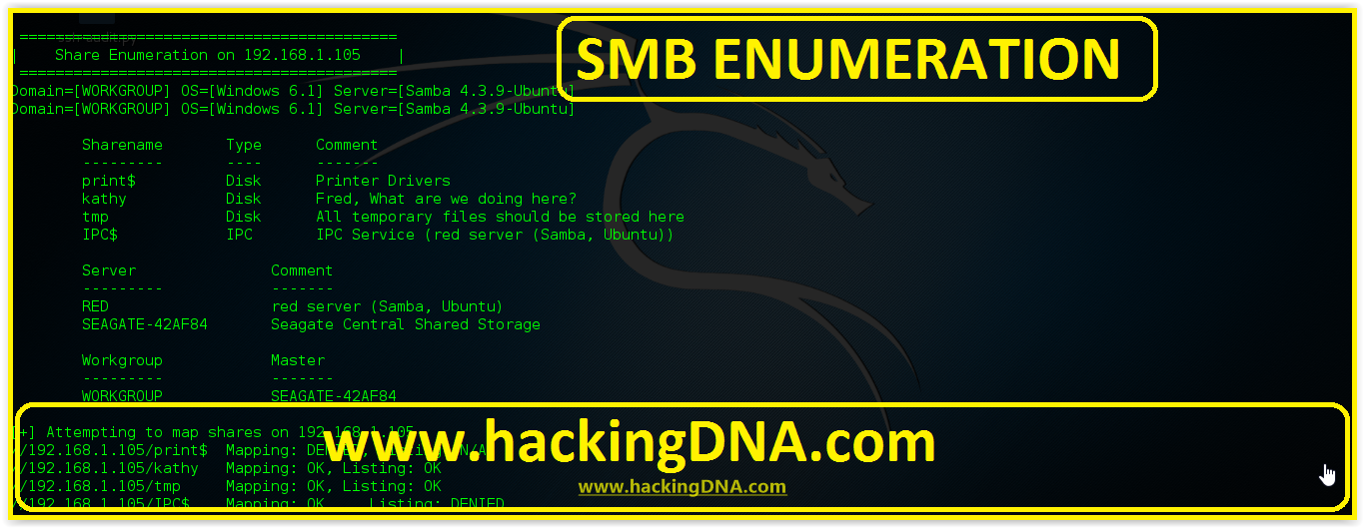
Share Enumeration
Definition:
Share enumeration involves identifying shared resources, such as files and printers, on a network, which may reveal sensitive information.
Examples:
1. Listing shared folders on a Windows network.
2. Identifying shared printers and their configurations.
Techniques and Tools:
Tools: smbclient, enum4linux, Nmap (with smb scripts).
Techniques: Use smbclient to list shares and access permissions. Test for anonymous access to shared resources.

Slide 14

Vulnerability Enumeration
Definition:
Vulnerability enumeration involves identifying and cataloging vulnerabilities in systems, networks, or applications that could be exploited by attackers.
Examples:
1. Scanning a web server for known software vulnerabilities.
2. Identifying outdated software versions on a network with known security flaws.
Techniques and Tools:
Tools: Nessus, OpenVAS, Qualys.
Techniques: Perform regular vulnerability scans and patch management. Use CVE databases to track known vulnerabilities.

Slide 15
Thank You!
Happy Hacking.

